Slide 1
Understanding and using the kit: Training of trainers for facilitators Module 2: Reaching and including adolescents
The Adolescent Development and Participation Section
Priya Marwah, Adolescents in Emergencies and Peacebuilding Specialist
Ellen Fransen, Programme Assistant
Juliet Young, Consultant

Slide 2
2.1 Understanding adolescents’ situations
Notes:
Cover slide for this first section of the webinar.

Slide 3
Discussion:
What are some of our knowledge gaps with respect adolescents ages 10-17 in our programming area?
Which adolescents ages 10-17 are less visible in our area?
What would it be helpful to know about adolescents’ situations as we plan and facilitate programmes to better reach and support them?
Notes:
Notes for trainer:
This step repeats a step from Module 1.2: Understanding adolescents in humanitarian contexts.
If workshop participants have already carried out that step, begin by asking them to refer to and summarize key points from that discussion.

Slide 4
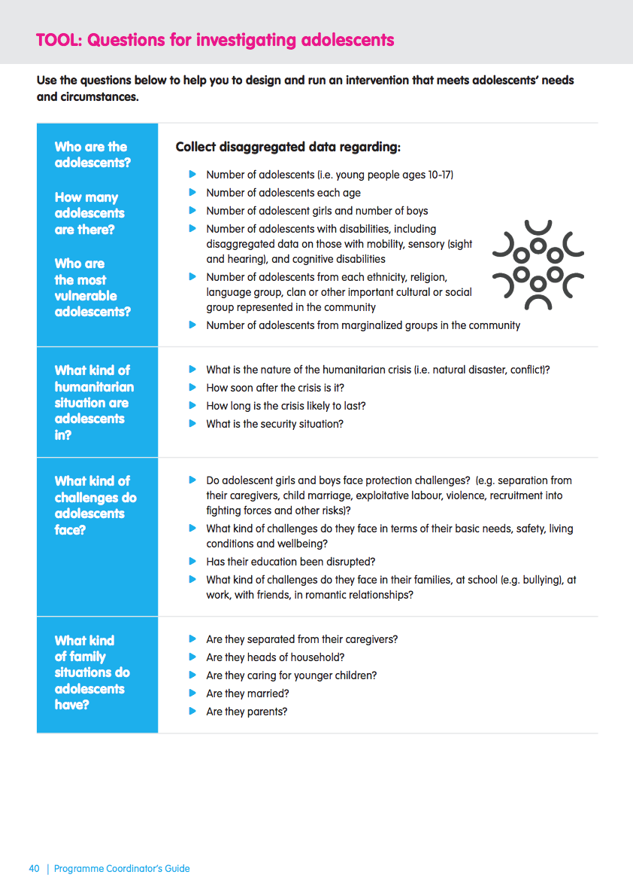
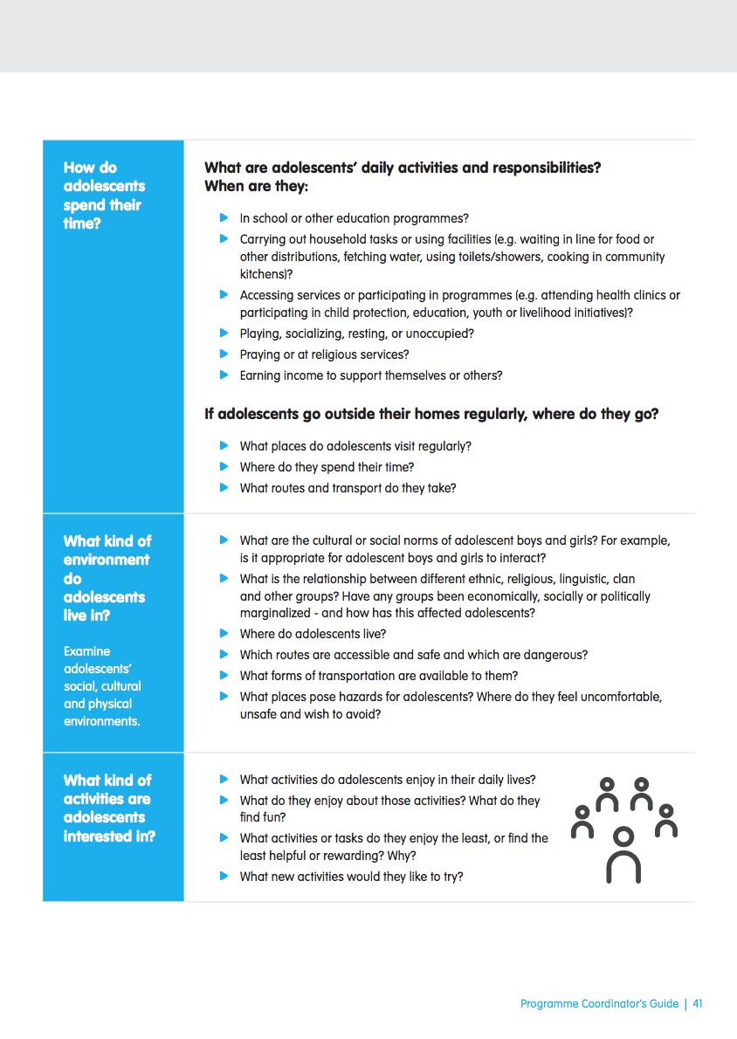
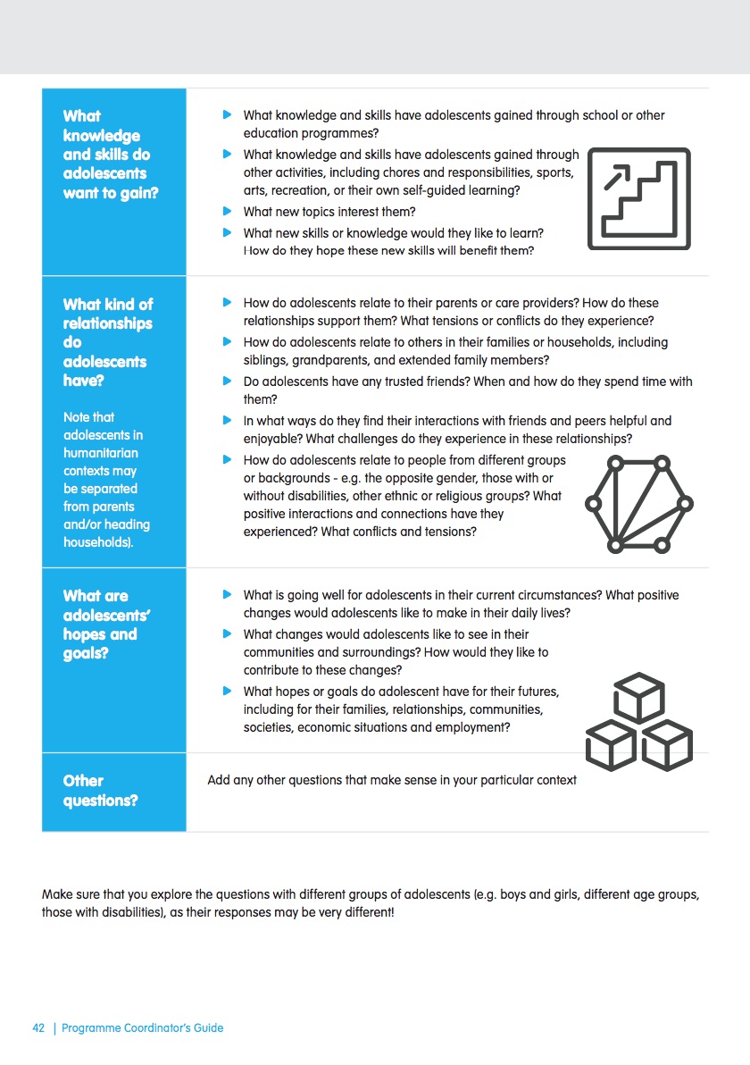
Activity:
Review the Programme Coordinators’ Guidance, Investigating adolescents’ situations, Questions for investigating adolescents’ tool.
Try to answer all of the questions in each section in as much detail as you can, based on your knowledge of adolescents’ situation in our programming context
Notes:
Notes for trainer:
Divide participants into pairs or small groups. Ask each pair or group to answer all the questions, OR ask each pair or group to focus on one or two categories of questions.
Ask participants to write answers to each question, including as much detail as they can.
As a follow-up discussion, ask:
Which questions could you answer in detail?
Which questions could you answer only briefly, and without as much detail as might be useful?
Are there any questions for which you don’t have the answer?
Additional questions for reflection and discussion:
For those questions to which we do have answers, what sources did we use to find that information?
Have we consulted directly with adolescents in seeking to answer those questions? Which adolescents have we consulted directly? Is it possible that our understandings of the answers to those questions might change if we heard from more adolescents?
Ref: Programme Coordinators Guidance, Investigate Adolescents’ Situation, Tool: Exploring challenges and opportunities for adolescents

Slide 5
Action planning:
What are some key gaps in our information about adolescents that we will work to fill?
What are some strategies we will use to gather that information?
Listen to
adolescents
Notes:
Notes for trainer:
To answer question 1, participants should reflect on key points that emerged from their discussions and activities in the last two steps.
To answer question 2, participants should review the Collecting information about adolescents tool and consider whether there are strategies from that tool that they can and should use, and/or plan additional strategies for gathering information about adolescents, including through consultative processes.
Participants should also review the Activities for learning from and about adolescents, with the Activity Guides listed in that resource, and consider which activities they might use to consult directly with adolescents in order learn more about their circumstances, perspectives and priorities.
Workshop participants should keep their notes from this module so that they can refer to their ideas when carrying out comprehensive roll-out planning.
Ref: Programme Coordinators Guidance, Investigate Adolescents’ Situation Collecting information about adolescents tool
Ref: Programme Coordinators Guidance, Investigate Adolescents’ Situation Activities for learning from and about adolescents
Ref: Activity Box Our days; Our environment; Our challenges, our solutions; Ourselves on the inside and outside; I am, I have, I can; Relationship map; Community dialogue; Organizing an exhibition

Slide 6
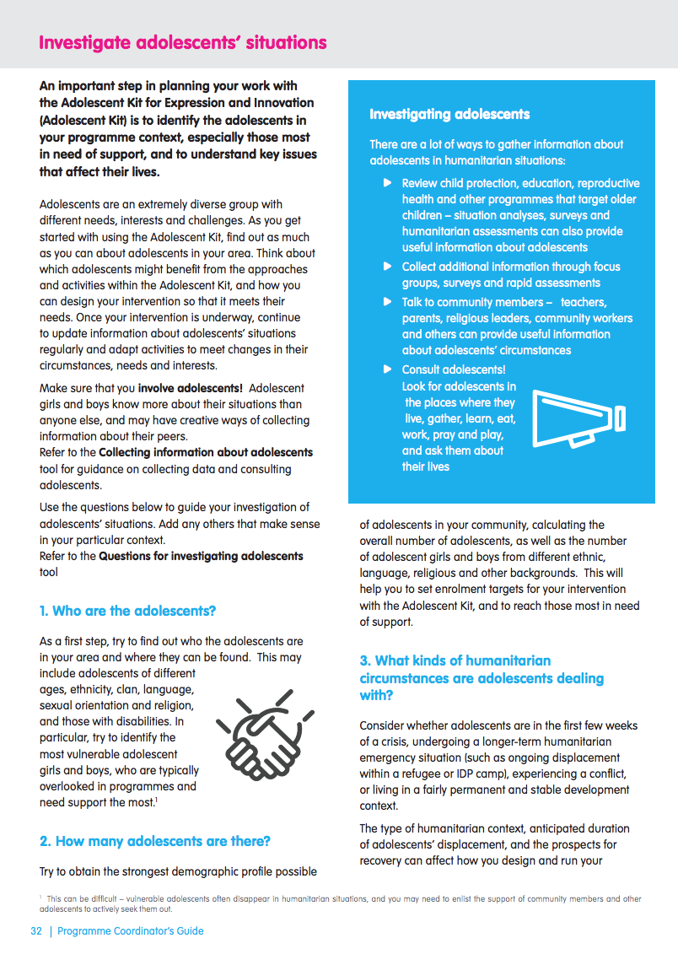
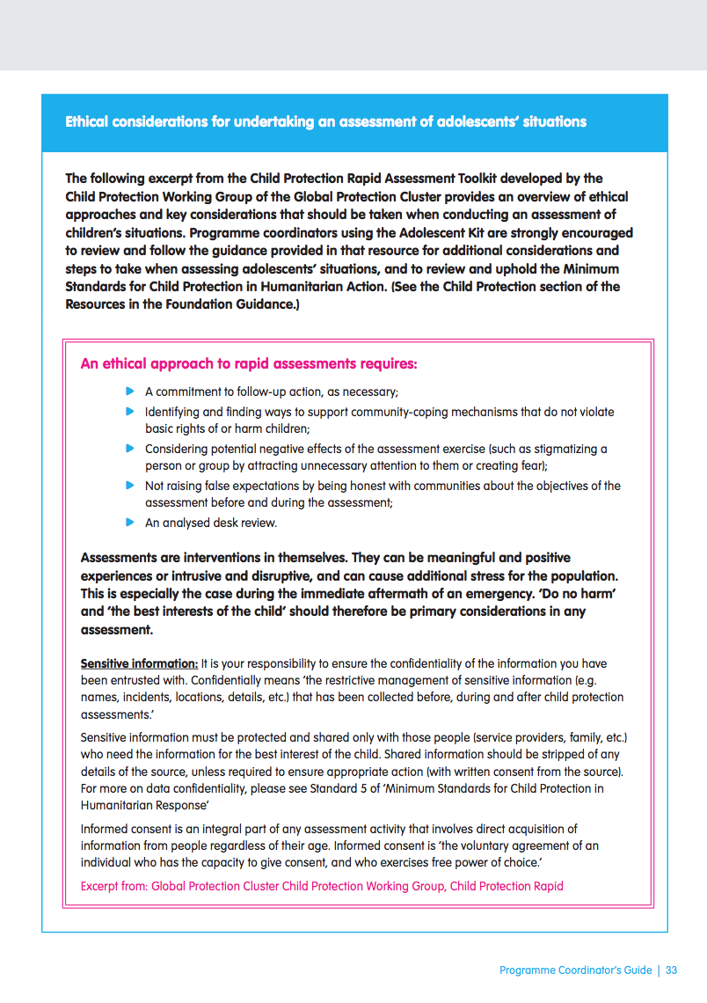
Do no harm!
Remember….
It is our responsibility to ensure the confidentiality of the information you have been entrusted with.
Sensitive information must be protected and shared only with those people (service providers, family, etc.) who need the information for the best interest of the child.
Shared information should be stripped of any details of the source, unless required to ensure appropriate action (with written consent from the source).
See Programme Coordinators’ Guidance: Investigate adolescents’ situation the Child Protection Rapid Assessment Toolkit, and the Minimum Standards for Child Protection in Humanitarian Response for more guidance on protecting and upholding the rights of children while gathering and using information on their situations. (Hyperlinks to those resources can be found in the Programme Coordinators’ Guidance)
Notes:
Note for trainer:
Ask and discuss:
Of the information we are planning to gather, what might be sensitive and therefore should be kept confidential?
What steps will we take to ensure confidentiality?
What steps will we take to ensure that adolescents and their parents or caregivers have given informed consent to our sharing information about their situations
Ref: Programme Coordinators’ Guidance: Investigate adolescents’ situation and the Child Protection Rapid Assessment Toolkit
Ref: Resources, Child Protection Section, Minimum Standards for Child Protection in Humanitarian Response
Ref: Activity Box Our days; Our environment; Our challenges, our solutions; Ourselves on the inside and outside; I am, I have, I can; Relationship map; Community dialogue; Organizing an exhibition

Slide 7
2.2 Reaching adolescents
Notes:
Cover slide for this first section of the webinar.

Slide 8
Discussion/activity:
Which adolescents will we reach through your programme using the resources in the Adolescent Kit?
Which groups/categories of adolescents are we reaching through our programme? | Which groups/categories are we struggling to reach so they can benefit from our programme?
Reach out to all adolescents
Notes:
Notes for trainer:
Participants can respond to these questions in plenary or work in small groups to answer the questions.
As a follow-up discussion ask:
What are some of the successful strategies we are already using to reach adolescents?
With respect to those adolescents who are not being reached by our programmes, what barriers are they facing to participating, and/or what challenges are we facing to reach and include them?

Slide 9
Discussion:
What strategies are we already using to reach and engage adolescents?
What new strategies could we use, especially to include those we are not reaching?
Reach out to all adolescents
Notes:
Notes for trainer:
To answer question 1, participants should reflect on key points that emerged from their discussions and activities in the last step.
To answer question 2, participants should review Programme Coordinators Guidance, Reach out and engage adolescents guidance, Adapting to changes in adolescents’ circumstances tool and Reducing barriers to adolescents’ attendance tool, and consider whether there are strategies from that guidance that they can and should use, and/or plan additional strategies for gathering information about adolescents, including through consultative processes.
Workshop participants should keep their notes from this module so that they can refer to their ideas when carrying out comprehensive roll-out planning.
Ref: Programme Coordinators Guidance: Reach out and engage adolescents
Ref: Programme Coordinators Guidance, Reach out and engage adolescents, Adapting to changes in adolescents’ circumstances tool
Ref: Programme Coordinators Guidance, Reach out and engage adolescents, Reducing barriers to adolescents’ attendance tool

Slide 10
2.3 Setting targets and monitoring for inclusion
Notes:
Cover slide for this first section of the webinar.

Slide 11
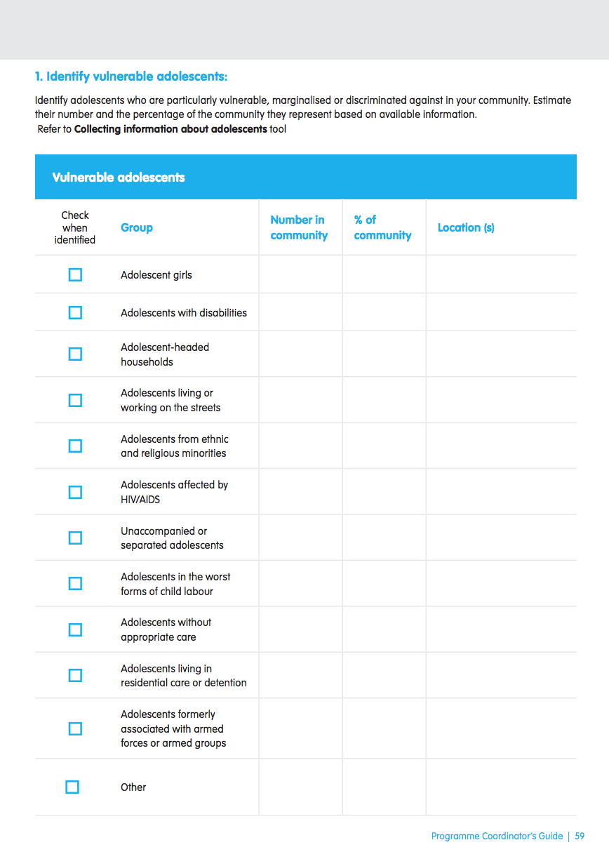
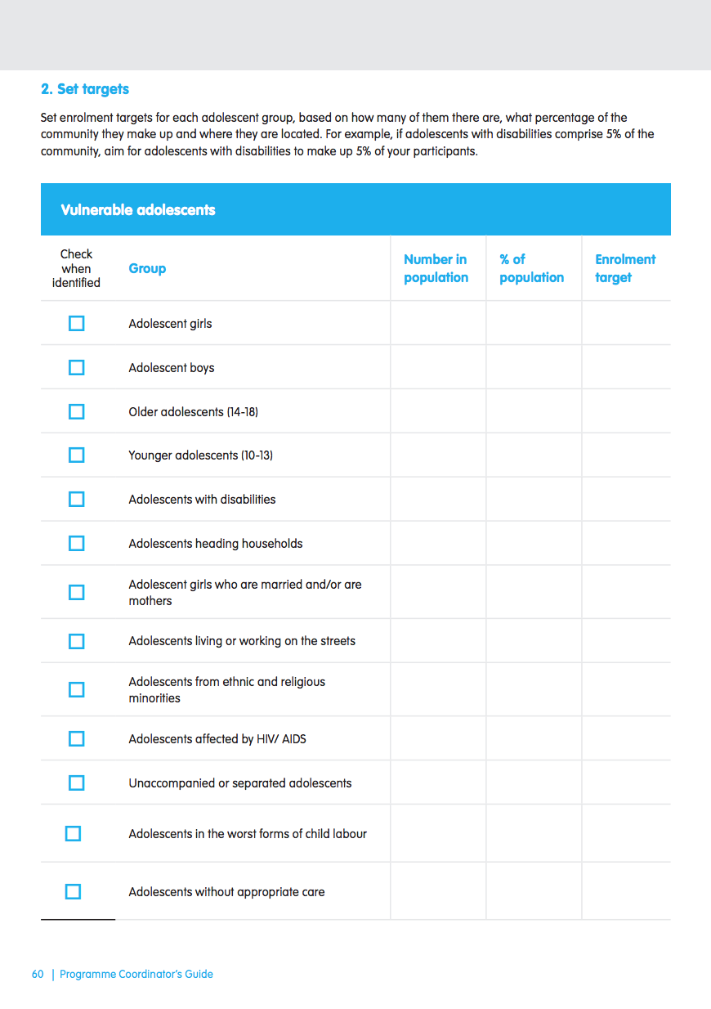
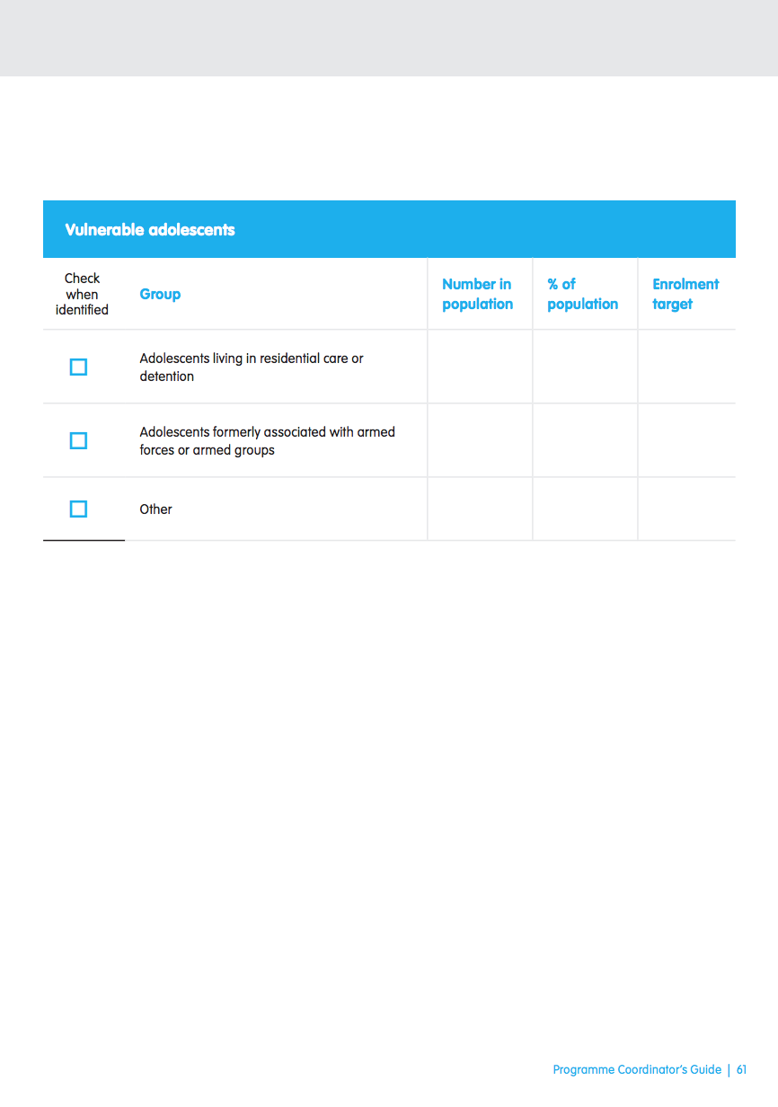
Discussion:
What are some of the key vulnerable groups in our programme context who are not being sufficiently reached or included in your programme or intervention?
Review the Setting enrolment targets tool in the Programme Guidance: Reach out and engage adolescents section.
What categories of least-reached adolescents in our programme contexts could we add?
Based on the data we have, what would be appropriate targets for the number of adolescents in each target we should aim to reach? OR
What new data should we gather to set appropriate targets for how many adolescents in those categories we should reach?
Notes:
Notes for trainer:
This module, including the next three steps, will be most effective if programme coordinators take an active role in aligning this activity to their programme goals, by:
Identifying categories of adolescents who should be reached and included through programmes and interventions;
Providing available data – or reliable estimates - on the numbers and percentages of adolescents in the programming contexts; and
Supporting workshop participants in setting appropriate targets based on data from the situation analysis.
Use the categories provided on this slide as examples to support participants’ understanding of different types of vulnerable and/or hard-to-reach groups of adolescents. The subsequent slides provide templates for setting targets.
Ref: Programme Coordinators Guidance, Setting Enrolment Targets tool.

Slide 12
Discussion/Activity:
Identify vulnerable groups.
Which groups of adolescents who are particularly vulnerable, marginalised or discriminated against in our community?
Estimate their number and the percentage of the community they represent based on available information.
Notes:
Notes for trainer:
Workshop participants should use this blank template to set estimates based on reliable data.
Ref: Programme Coordinators Guidance: Reach out and engage adolescents, Setting enrolment targets tool.

Slide 13
Discussion/Activity:
Set targets.
Set enrolment targets for each adolescent group, based on how many of them there are, what percentage of the community they make up and where they are located.
Notes:
Notes for trainer:
Workshop participants should use this blank template to write estimates using reliable data provided by programme coordinators.
Recommendation: Provide and use a paper copy of this template, either on A4-sized paper or drawn on large flipchart paper, for participants to fill in during this activity.
Ref: Programme Coordinators Guidance: Reach out and engage adolescents, Setting enrolment targets tool.

Slide 14
Do no harm!
Remember….
It is our responsibility to ensure the confidentiality of the information you have been entrusted with.
Sensitive information must be protected and shared only with those people (service providers, family, etc.) who need the information for the best interest of the child.
Shared information should be stripped of any details of the source, unless required to ensure appropriate action (with written consent from the source).
See Programme Coordinators’ Guidance: Investigate adolescents’ situation the Child Protection Rapid Assessment Toolkit, and the Minimum Standards for Child Protection in Humanitarian Response for more guidance on protecting and upholding the rights of children while gathering and using information on their situations. (Hyperlinks to those resources can be found in the Programme Coordinators’ Guidance)
Notes:
Note for trainer:
Ask and discuss:
Of the information we are planning to gather, what might be sensitive and therefore should be kept confidential?
What steps will we take to ensure confidentiality?
What steps will we take to ensure that adolescents and their parents or caregivers have given informed consent to our sharing information about their situations
Ref: Programme Coordinators’ Guidance: Investigate adolescents’ situation and the Child Protection Rapid Assessment Toolkit
Ref: Resources, Child Protection Section, Minimum Standards for Child Protection in Humanitarian Response
Ref: Activity Box Our days; Our environment; Our challenges, our solutions; Ourselves on the inside and outside; I am, I have, I can; Relationship map; Community dialogue; Organizing an exhibition

Slide 15
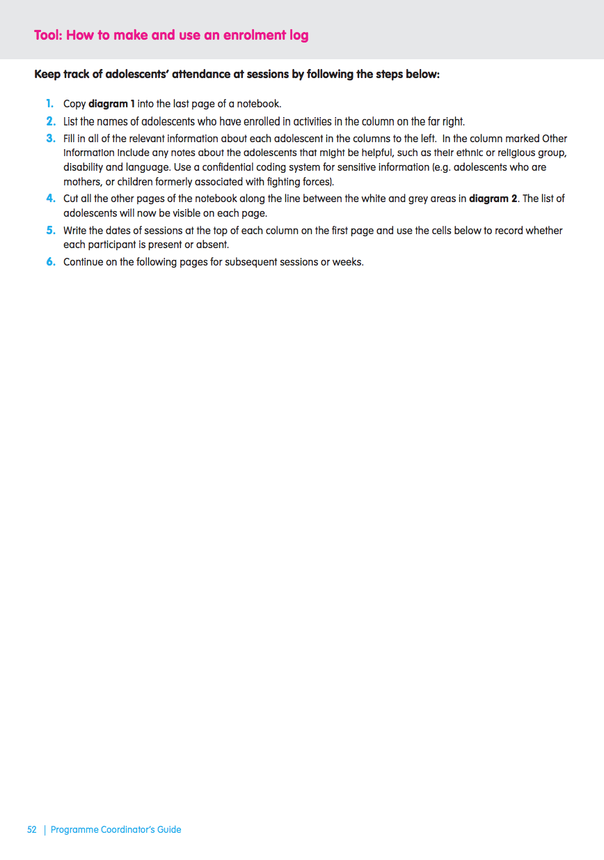
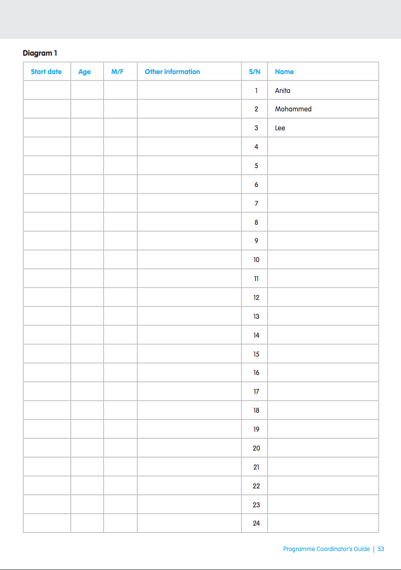
Discussion/Activity:
Preparing to monitor adolescents’ attendance.
How will we adapt this (or another) attendance monitoring tool?
How will we prepare and support facilitators to use it (regularly and correctly)?
How often will we gather and analyze attendance data for our programme to monitor whether we are meeting our enrolment targets, especially for those adolescents from marginalized and hard-to-reach groups?
Notes:
Notes for trainer:
Workshop participants should use this blank template to set targets based on their estimates from the previous steps.
Recommendation: Provide and use a paper copy of this template, either on A4-sized paper or on large flipchart paper, for participants to fill in during this activity.
Ref: Programme Coordinators Guidance: Reach out and engage adolescents, How to Make and Use an Attendance Log tool.

Slide 16
Action planning:
If we find that we are not meeting our enrolment targets, what actions can we take to reach and engage adolescents (especially those from hard-to-reach groups) in our progarmme ?
Include all
adolescents
Notes:
Notes for trainer:
To answer this question participants should again review Programme Coordinators Guidance, Reach out and engage adolescents, Adapting to changes in adolescents’ circumstances tool and Reducing barriers to adolescents’ attendance tool, and consider whether there are strategies from that tool that they can and should use, and/or plan additional strategies for gathering information about adolescents, including through consultative processes.
They should also review the strategies they developed for gathering additional information on adolescents’ situations, and discuss adjustments or modifications they can make to programmes to make programmes more accessible and relevant for adolescents based on circumstances, interests and priorities.
Programme coordinators may recommend that trainers include a session on how to make and use an enrolment log, using the tool of the same name in the Programme Coordinators’ Guidance.
Workshop participants should keep their notes from this module so that they can refer to their ideas when carrying out comprehensive roll-out planning.
Ref: Programme Coordinators Guidance, Reach out and engage adolescents, Adapting to changes in adolescents’ circumstances tool
Ref: Programme Coordinators Guidance, Reach out and engage adolescents, Reducing barriers to adolescents’ attendance tool

Slide 17
Thank you!
Notes:
Cover slide for this first section of the webinar.

